Slide 1
Keep Your Head in the Clouds
Blackboard’s Transition from Enterprise to Cloud Software Through DevOps
David Ashman
Chief Architect, Cloud Architecture
@davidbashman

Slide 2
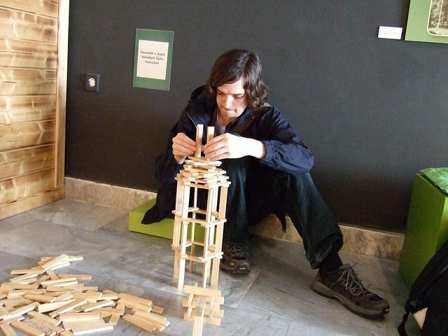
Notes:
So who am I. I build things for Blackboard.

Slide 3
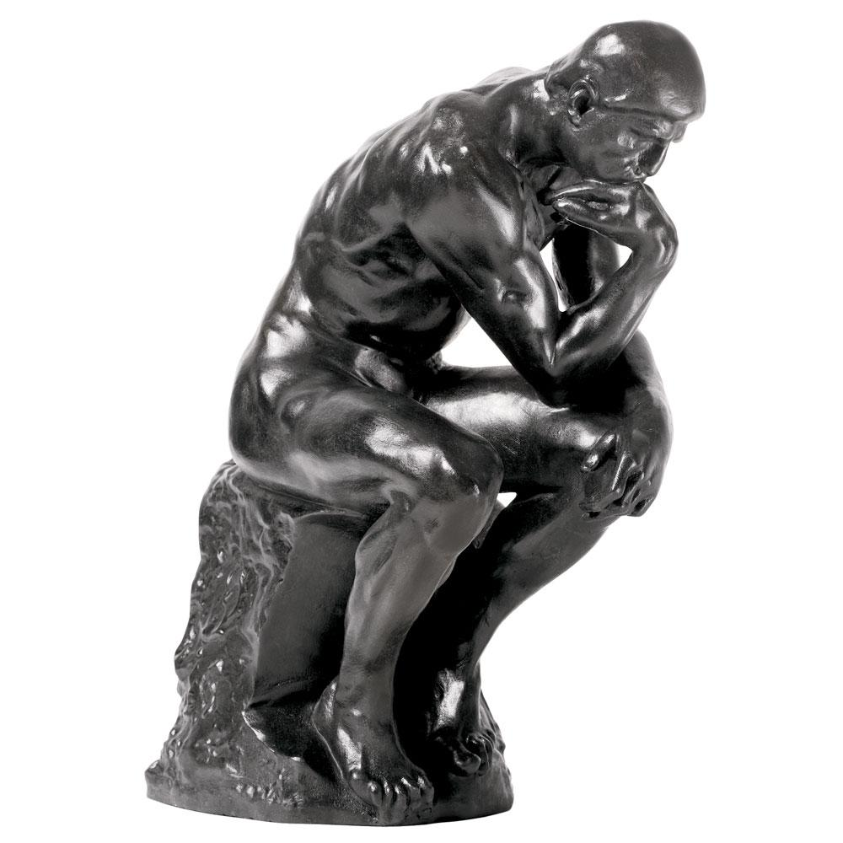
Notes:
And I think a lot. Though, usually I do this with clothes on… especially at the office.

Slide 4

Notes:
Sometimes I manage people

Slide 5
Notes:
But really, I build things for Blackboard.

Slide 6

Notes:
And just generally try to make things better. And this presentation is about just that – making things better at Blackboard through DevOps.

Slide 7

The industry leader in educational technology and services
17 years young
Privately held
$450M revenue at time of going private
Headquarters in Washington, DC
Notes:
First a little bit about Blackboard:
Went private in 2011

Slide 8
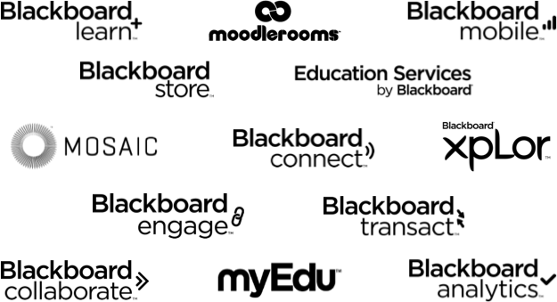

Notes:
Extensive portfolio of teaching and learning, communications and analytics products and services. These products serve all stages of education from K through16 and on into adult continuing education. But today I’m going to focus on our flagship Learn platform.

Slide 9
Blackboard Learn
17 year old codebase with roots in Perl
Millions of lines of Java code (Hybrid Java/Perl for many years)
7 development/operations offices, worldwide
700 people between development, testing and operations (All products)
~3000 virtual machines across 1000 clients in hosting
~8PB of content and data storage

Slide 10
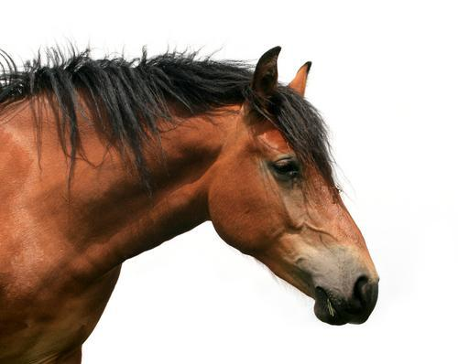
We are a horse.
Notes:
Backstory - Gene Kim (the conference creator) describes companies as unicorns (“fictionally” perfect companies like Netflix, Ebay, Etsy, Facebook, etc) and horses (everyone else). He postulates that DevOps is even more valuable to the horses than the unicorns of the world.

Slide 11
And like so many of you...
6+ month lead times
Technical debt
High update failure rates
Poor communication paths from development to operations
Poor feedback loops from operations to development
Notes:
Describes the common enterprise issues that we face like so many other companies at the conference. Creates connection with others at the conference.

Slide 12
But through the art of DevOps...

Slide 13
We are a horse.

Slide 14
better
We are a horse.
^
Notes:
Draws focus towards our improvements as a company.

Slide 15
What changed?
Automation
Cloud Infrastructure
Culture

Slide 16
Automation

Slide 17

Problem
LOC
# of code commits
Notes:
For the product, we wanted to increase our release cadence and fix issues faster in the field. To do this, we took on modularizing our product.

Slide 18


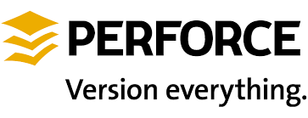
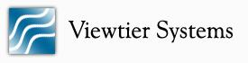

Notes:
Tried to contain the growth by introducing tools to improve the build performance and visibility.

Slide 19

Notes:
Ultimately, we were building a monolith. And with that came:
Poor product quality
Slower release times
More instability
Slower developer productivity

Slide 20
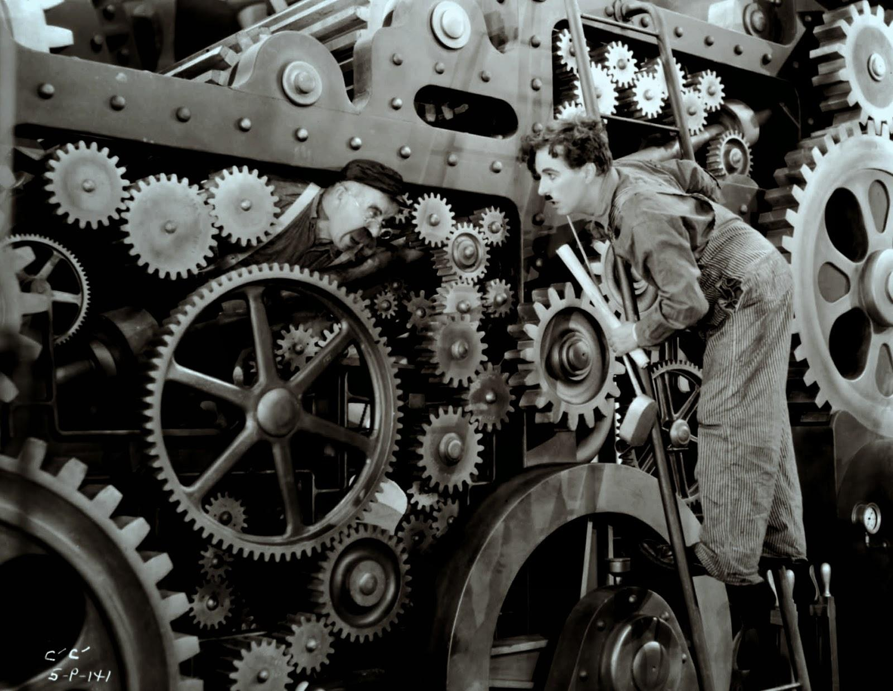
24-36 Hours
Notes:
The machine was getting more and more complex and error prone. And the larger the product got, the longer the lead times got.
24-36 Hour integration feedback

Slide 21
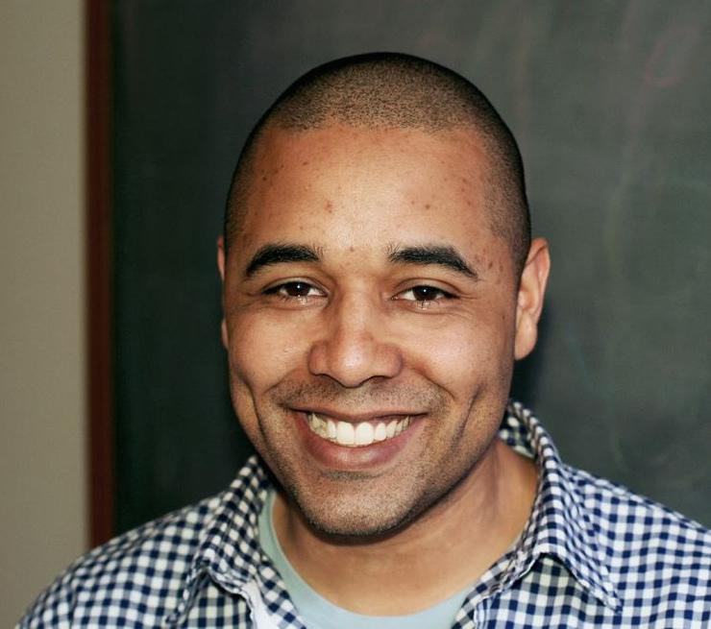
Mike McGarr
Notes:
Enter Mike McGarr. Though no longer at Blackboard, he was hired by Steve Feldman, another former blackboarder here this week, to really kickstart DevOps.

Slide 22

Notes:
Mike brought a different mindset to our team. He started to push the team to think about new ideas.

Slide 23
Problem
LOC
# of code commits
Notes:
For the product, we wanted to increase our release cadence and fix issues faster in the field. To do this, we took on modularizing our product.

Slide 24
Wat
Problem
LOC
# of code commits
Notes:
For the product, we wanted to increase our release cadence and fix issues faster in the field. To do this, we took on modularizing our product.

Slide 25


LOC
# of code commits
Notes:
This made for some impressive improvements in code modularity and in combination with the updates to our build process, better feedback to the developers. This graph shows the shift from our previous monolithic codebase to our modular codebase that can be built in pieces.

Slide 26




Notes:
He replaced the antiquated build tools. He started to introduce automation tools like Chef and Puppet to our integration test infrastructure. And this wasn’t just replacing our current build with a new one. He was introducing tools that allowed developers to do their own operations work. He was taking us towards DevOps.

Slide 27
15-30 Minutes
24-36 Hours

Slide 28
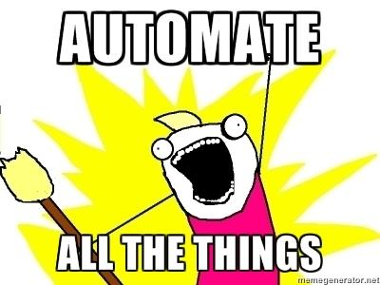

Slide 29
But wait... There’s more!
Functional Acceptance Testing

Slide 30
Value
Problem!
4 hours
15 minutes
1 hour
1 hour
5 minutes
15 minutes
Code
Commit/
Build/
Integrate
Test Suite
Analyze Failed Tests
Create
Ticket
Assign
Ticket
5 minutes
36
hours
24
hours
5 minutes
6
hours
Waste (wait)
6 hours (value)
= 9% Efficient
70 hours total time

Slide 31
Development
Testing
(2-5 days)
Commit
3-6+ days
Project Management
Ticket

Slide 32
100s of Failures
60% script issues
(invalid tests, out of sync with functionality)
30% data/environment issues
(data left in the database or filesystem)
7% pre-existing issues
3% newly discovered issues

Slide 33
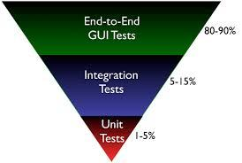
Problem
Notes:
Old acceptance tests *heavily* skewed towards GUI tests.

Slide 34
The Problem
Elongated testing cycles (3+ months)
Longer time to market
Reduced visibility to our development team
Long delays between coding and fixing
Too much noise distracting us from product improvements

Slide 35
Test Automation
TDD
Fully automated acceptance testing pipeline
< 30m acceptance test feedback
New testing approaches (Jasmine, Protractor, RESTAssured)
6+ month lead time
1-2 week lead time

Slide 36
Cloud Infrastructure

Slide 37

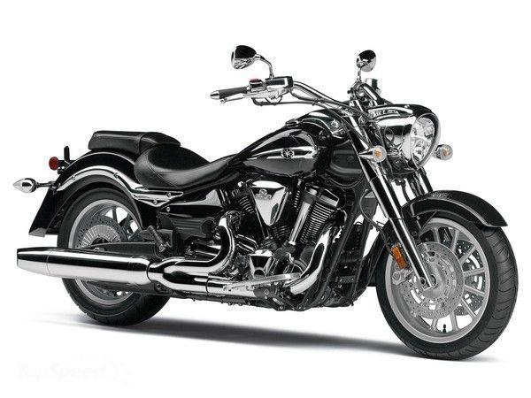
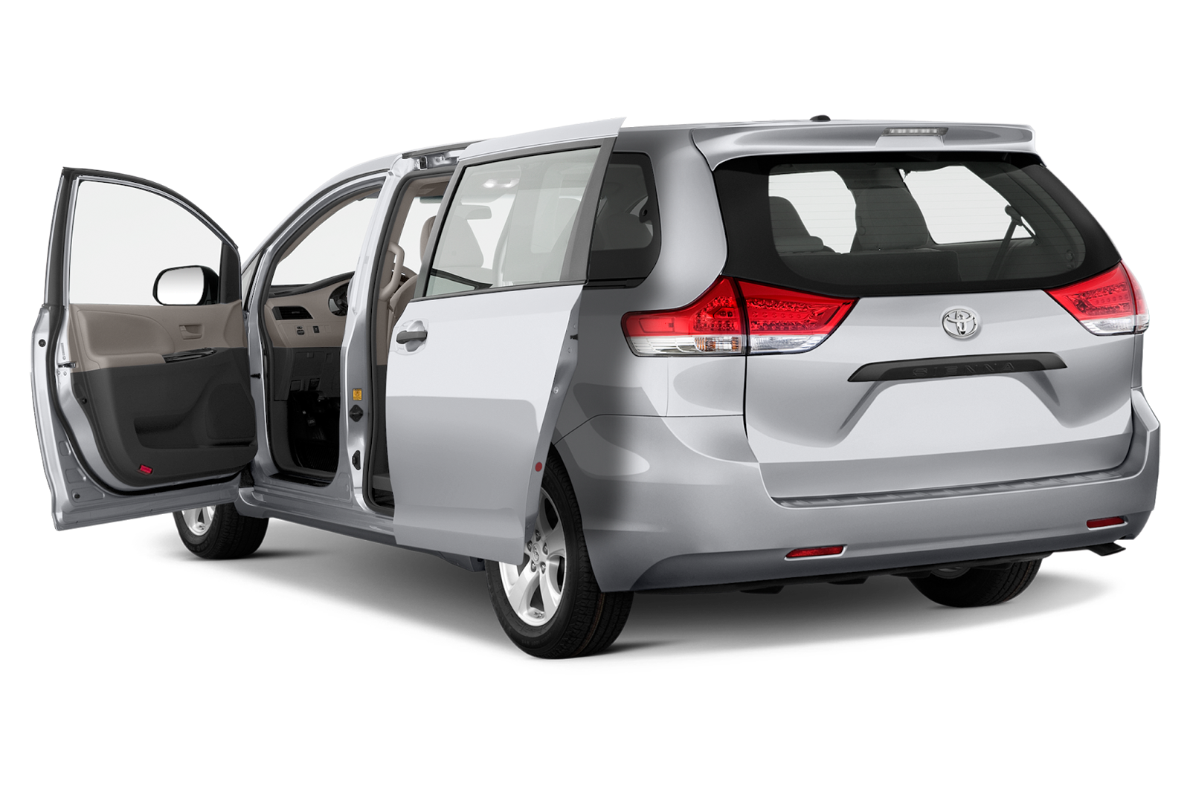
Product Development
Operations
!=
!=
Development
Test
Production
Notes:
Differentiation between test deployment environments creates inconsistent testing results. “It worked on my machine” syndrome.

Slide 38
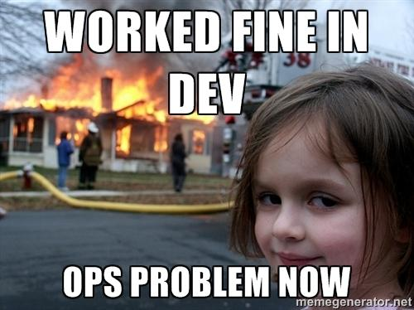

Slide 39
Deployment Environments
Snowflakes - No two environments were alike
Completely different deployment methods
Manual development builds
Automated installs in testing
Gold master images in production
Completely different deployment architectures
Windows development machines
Linux VMs in testing
Linux clusters in production

Slide 40
Development
Operations
Notes:
Chef began to take hold, but we had two completely separate efforts with minimal knowledge sharing.

Slide 41

Notes:
The promise of cloud computing was our next stage.

Slide 42

Notes:
I got the opportunity to build a super team of development and operations engineers to take on an shadow project - to take our flagship product, Blackboard Learn, into the cloud.

Slide 44

Learn in the Cloud
Everything, from the ground up, is automated.
Orchestration in code - stored in SCC, executed in ALL deployment environments.
On demand provisioning for developers.
Still develop on their laptops, but can now test in a real deployment environment.

Slide 45

BbCloud
OpenStack in our data centers
Abstract cloud fabric to gain benefits in both clouds
Centralized, standardized Chef automation
Increased visibility for development
Monitoring, APM, statsd, centralized logging

Slide 46
Culture

Slide 47

Notes:
As an organization, we were very siloed. Every team just packaged up a deliverable and passed it over to the next team. Dev built a product and handed it off to QA for testing. Washed it’s hands and moved on. QA handed the GA build to operations and washed it’s hands. Operations was left on it’s own to make it work with very little feedback to the development team. There was no shared responsibility.

Slide 48
“QA is responsible for defining the testing strategy.”
“QA is responsible for checking quality when a feature is done.”
“Unit testing is not enough to verify a feature.”

Slide 49
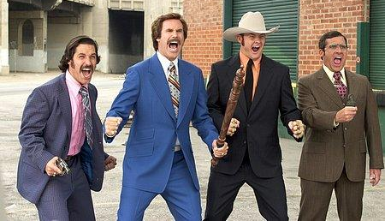

Development
Operations

Slide 50
Executive Buy-in
Notes:
Key to cultural change at Blackboard was executive buy in. Once the team saw that the leadership wanted devops, the tide shifted.

Slide 51

Notes:
Single biggest change was bringing the groups together into one organization. We put people in leadership positions that cared about development and operations in one. We placed development groups into the infrastructure and IT teams. We integrated application operations teams back into the development teams.

Slide 52
X
Notes:
And we automated all the things! No, you can’t automate culture changes. This takes human capital.

Slide 53
What we’ve achieved
Development teams deploying their production environments.
Developers solving operational issues in production.
Open feedback loops on operational issues.
Data-driven decisions based on that feedback.

Slide 54

Notes:
And most importantly, we are finally talking.

Slide 55
I might be able to help...
Understand the impact that cloud computing can have on DevOps even in an “enterprise” company.
Understand the cost models comparing cloud computing and traditional hosting.
Frame your pitch to the executive team to make material changes in your company culture.
Notes:
I was honored to be invited to speak along side some of the leaders in DevOps. I hope that I can offer something back to the community here. «

Slide 56
I’d like to learn more about...
Effective testing strategies for traditionally manual tests (UI, etc).
Applying DevOps strategies for shipped-to-premise software.

Slide 57


Thanks!
dashman@blackboard.com
@davidbashman

